Slide 1
Data 557 A Wi 23: Applied Statistics And Experimental Design
Indian Stock Markets Data:
Analysis of Market Indicators
Team Members
Sagnik Ghosal
Arjun Sharma
Raman S V
Adithyaa V

Slide 2

PROJECT MOTIVATION
Intended Audience: Investors across levels of expertise.
The ability to forecast and accurately predict the future performance of stocks and indices is paramount for an investor. Stock performance is quite volatile as it can be influenced by circumstances like international events, human behavior, etc. This makes it challenging to accurately forecast or predict the direction of the market.
The motivation of this project is to evaluate the validity of some common stock market indicators in accurately predicting stock market returns. In addition, we also compare the effectiveness of investing in an index to investing in individual stocks.

Slide 3
DATA SOURCES
Stocks Data
Web scraped data from the National Stock Exchange (NSE)
Stock Data:
Daily stock archives from 2016 – 2022.
Contains information for over 1500 stocks.
Nifty50 Data:
Daily index records from 2016 – 2022.
Index of top 50 stocks from the NSE.
Pre-existing Data
Calculated Fields
- Open
- Close
- High
- Low
- Typical Price
- Total Trade Quantity
- Total Trade Value
- CCI
- RSI
- MACD
- Returns
- Rolling Returns (Mean)
- Rolling Returns (SD)

Slide 4
Placeholder Slide
Risk Free Return
Index Return

Slide 5
SPECIFIC QUESTIONS TO BE ADDRESSED
Are prominent market indicators reliable as to when one should buy or sell shares? In particular, we focus on the following indicators:
CCI (Commodity Channel Index)
RSI (Relative Strength Index)
MACD (Moving Average Convergence Divergence)
Is it a better strategy to buy and hold an index compared to buying individual shares? Analyze the risk free returns and compare it to the market returns.

Slide 6
Process Overview – Question 1
Stage 1:
Correlation Analysis
Observe correlation strength between different indicators and the stock price across stocks
Stage 2:
t-test for average market returns compared to indicator-informed purchase decisions
Establish whether using indicators to purchase stocks is a better strategy than investing in an index
Stage 3:
Linear Regression to predict price rolling averages
Predict future prices based on indicator data and past prices. Evaluate whether a strong relationship exists between the predictors and the stock prices.

Slide 7
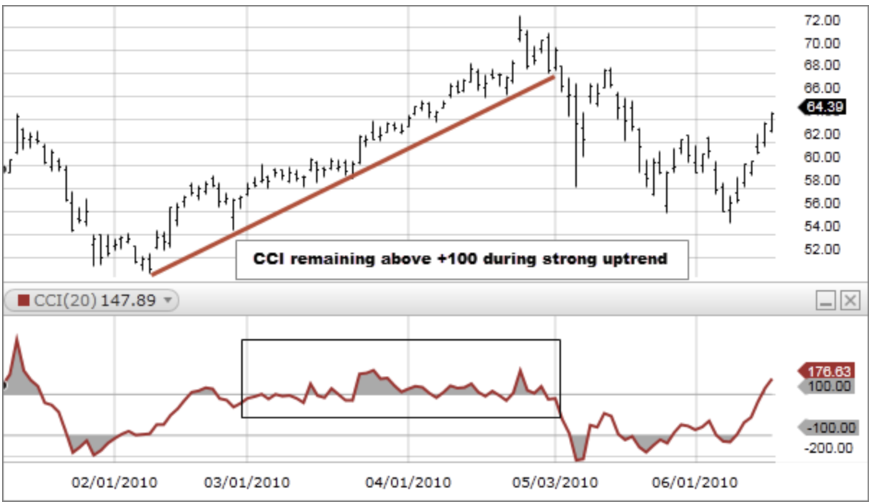
DESCRIPTION OF THE INDICATORS
CCI (Commodity Channel Index):
Helps identify potential overbought or oversold conditions in an asset price.
CCI above +100 is considered overbought and below -100 is considered oversold.

Slide 8
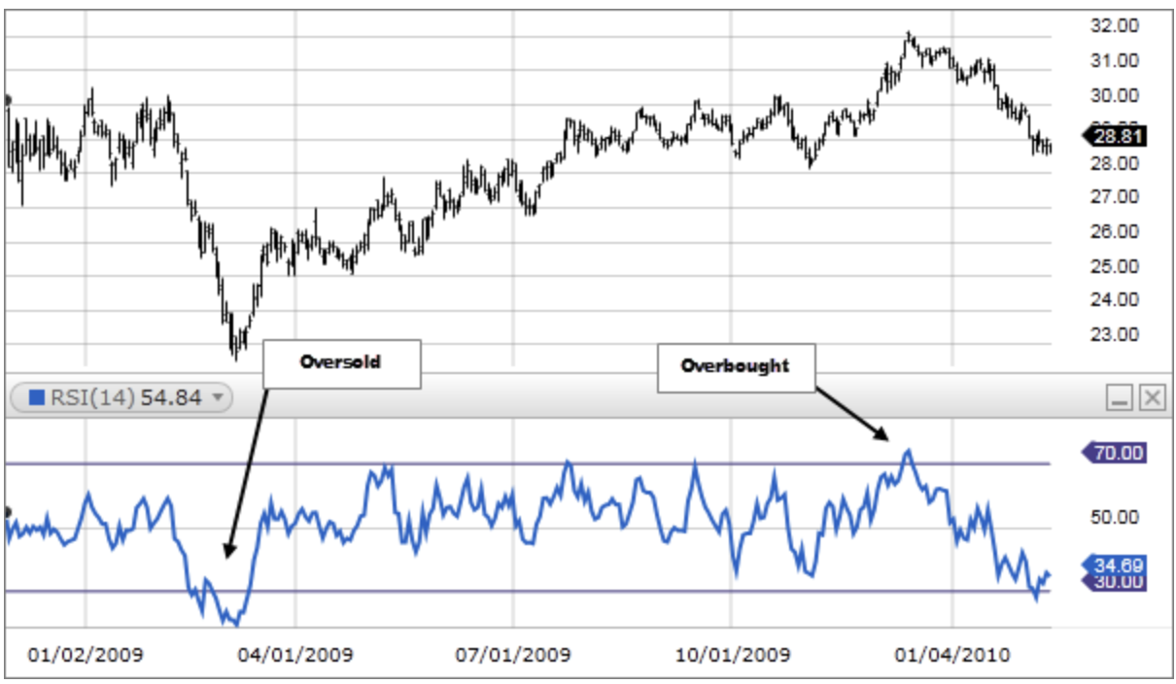
DESCRIPTION OF THE INDICATORS
RSI (Relative Strength Index):
Measures the strength of a stock's price action to identify overbought or oversold conditions
RSI above 70 is considered overbought and below 30 is considered oversold.

Slide 9
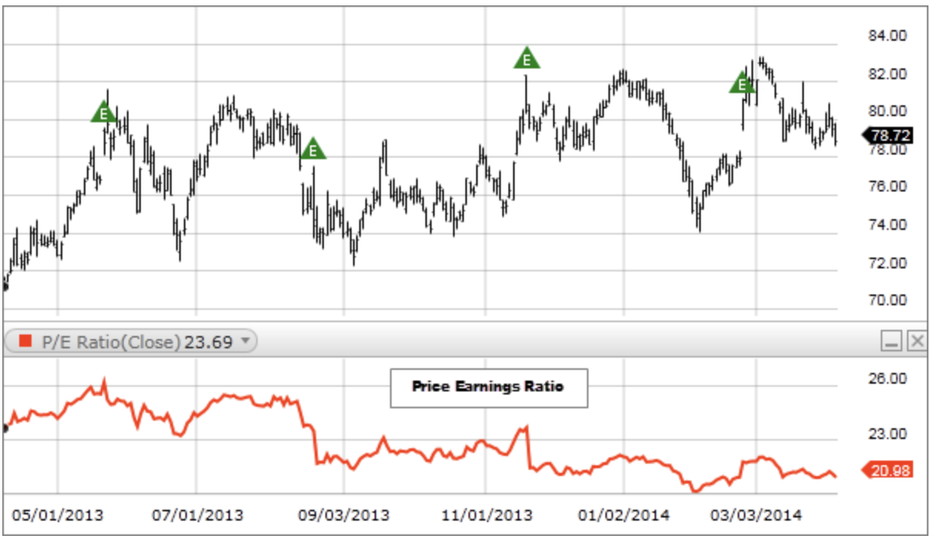
DESCRIPTION OF THE INDICATORS
PE Ratio (Price-to-Earnings Ratio):
A measure of the market's expectation of a company's future earnings growth
Doesn't consider the company's debt, earnings quality, or other factors that can impact the stock's future performance.
This is traditionally considered a core tool for fundamental analysis, but we want to analyze the impact of “buying cheap” from a technical standpoint.

Slide 10
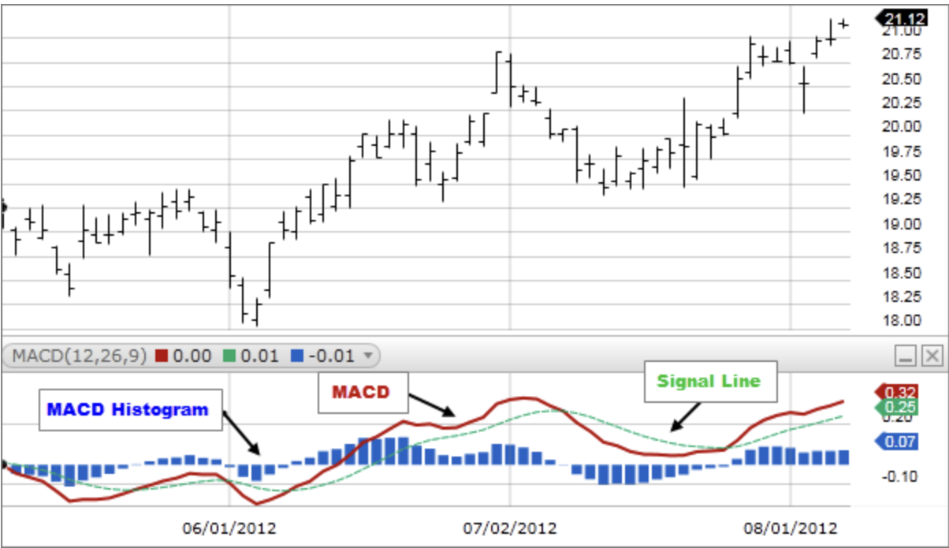
DESCRIPTION OF THE INDICATORS
MACD (Moving Average Convergence Divergence):
Identify trends and potential trend reversals in stock prices.
Calculated using two moving averages and a histogram.
A positive histogram indicates that the MACD Line is above the Signal Line, indicating upward momentum, while a negative histogram indicates downward momentum.
Analyze golden cross and death cross and if their impact is overrated.

Slide 11
Question 1: Are prominent market indicators reliable as to when one should buy or sell shares?

Slide 12
Question 2: Index vs Individual Stocks
Is it a better strategy to buy and hold an index compared to buying individual shares?
Background:
We compare top performing individual stocks with the Nifty50 index.
The metric for comparison is the 30 day rolling returns.
Assumptions:
The returns of the stock(s) and the Index are normally distributed.
The returns of the stock(s) and the Index have unequal variances [].
Testing Conditions:
Test Performed: Welch test (t-test with unequal variance)
Significance Level: α = 0.05
The test is repeated for all individual stocks vs. Nifty50 index (91 iterations)

Slide 13
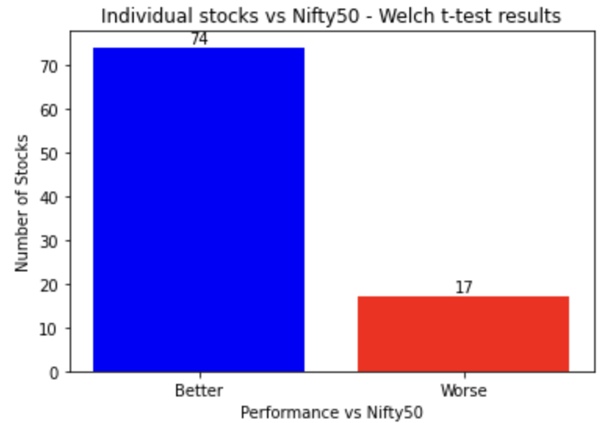
Question 2: Index vs Individual Stocks
Hypothesis Formulation:
H₀: There is no difference between index returns and those
from an individual stock.
H_{A}: Returns obtained through an individual stock are greater
than index returns.
Results:
We ran the test for 91 stocks, each compared to the Nifty50 index.
For 74 of the individual stocks, we reject the null hypothesis that the individual stock returns are not different from that of the Nifty50 index. More details here.
Interpretation: We infer that we are better off separately investing in 74 stocks, rather than investing in the Nifty50 index.

Slide 14
REFERENCES
[1] Commodity Channel Index (CCI), Fidelity Investments: https://www.fidelity.com/learning-center/trading-investing/technical-analysis/technical-indicator-guide/cci
[2] Relative Strength Index (RSI), Fidelity Investments: https://www.fidelity.com/learning-center/trading-investing/technical-analysis/technical-indicator-guide/RSI
[3] Price to Earnings Ratio (PE Ratio), Fidelity Investments: https://www.fidelity.com/learning-center/trading-investing/technical-analysis/technical-indicator-guide/pe-ratio
[4] MACD, Fidelity Investments: https://www.fidelity.com/learning-center/trading-investing/technical-analysis/technical-indicator-guide/macd
[5] Investopedia: https://www.investopedia.com/
[6] Mallikarjuna, M., Rao, R.P. Evaluation of forecasting methods from selected stock market returns. Financ Innov 5, 40 (2019). https://doi.org/10.1186/s40854-019-0157-x

